Slide 1
The Data Design Recipe
CS 5010 Program Design Paradigms “Bootcamp”
Lesson 1.3
© Mitchell Wand, 2012-2014
This work is licensed under a Creative Commons Attribution-NonCommercial 4.0 International License.

Slide 2
Learning Objectives for this Lesson
By the time you finish this lesson, you should be able to:
list the steps in the data design recipe
list the pieces of a data definition
explain what define-struct does
write a constructor template and interpretation for simple data

Slide 3
The Data Design Recipe
1. What information needs to be represented in your program? What kind of information is each piece?
2. Structure Definitions
3. Constructor Template
4. Interpretation
5. Observer Template
6. Examples
7. Review
Notes:
Here is the data design recipe.

Slide 4
DDR Step 1. What information needs to be represented?
This is usually pretty clear; depends on the application.
In general, information needs to be represented when it might take many values, and your program needs to know which one is right.

Slide 5
Example: representing a car
How does one car differ from another?
In a traffic simulation, I might only need to keep track of each car's position and velocity
For TV coverage of an auto race, I might need to keep track of enough information to distinguish it from all the others in the race.
For an auto dealer, I might need to keep track of enough information to distinguish this car from all the others in the world.

Slide 6
Example: representing a car
Also need to keep track of other information that is needed by the application, of course.

Slide 7
DDR Step 2. Structure definitions
In Racket, we represent compound data as a struct
This is like a struct or record in other languages.
For mixed data, we may need several structs
we'll see an example later
In Racket, we define new kinds of structs or records with define-struct.
We saw these in Lesson 0.4. Here’s a review:

Slide 8
Example of a structure definition in Racket
(define-struct book (author title on-hand price))
Executing this define-struct defines the following functions:
make-book
book-author
book-title
book-on-hand
book-price
book?
A constructor– GIVEN 4 arguments, RETURNS a book with the given fields
Selectors: GIVEN: a book, RETURNS: the value of the indicated field.
A Predicate: GIVEN: any value, RETURNS: true iff it is a book

Slide 9
DDR Step 3. Constructor Template
Tells how to construct a value of this type.
We’ll start with the most general case– mixed data– and then see how the others are special cases.

Slide 10
Remember our example of mixed data
In a wine bar, an order may be one of three things: a cup of coffee, a glass of wine, or a cup of tea.
For the coffee, we need to specify the size (small, medium, or large) and type (this is a fancy bar, so it carries many types of coffee). Also whether or not it should be served with milk.
For the wine, we need to specify which vineyard and which year.
For tea, we need the size of the cup and the type of tea (this is a fancy bar, so it carries many types of tea).

Slide 11
Recipe for a constructor template
Write down one struct definition for each alternative.
Then write down the constructor template showing the type of each field.
Example:

Slide 12
Struct definitions and constructor template for mixed data: example
(define-struct coffee (size type milk?))
(define-struct wine (vineyard year))
(define-struct tea (size type))
;; A BarOrder is one of
;; -- (make-coffee Size Type Boolean)
;; -- (make-wine Vineyard Year)
;; -- (make-tea Size String)
The structure definitions
The constructor template

Slide 13
The constructor template in more detail
;; A BarOrder is one of
;; -- (make-coffee Size Type Boolean)
;; -- (make-wine Vineyard Year)
;; -- (make-tea Size String)
Presumably Size, Type, Vineyard, etc. are data types defined elsewhere
The kind of data in each field

Slide 14
Example of a constructor template (compound data)
For compound data, there’s only one alternative, so you’d write one struct definition and have one line in the constructor template:
(define-struct book (author title on-hand price))
;; A Book is a
;; (make-book String String NonNegInt NonNegInt)
The kind of data in each field

Slide 15
Sometimes this format isn't enough
Example: a ring
inner
inner radius
outer radius

Slide 16
Constructor Template for a ring
You could apply make-ring to any two numbers
But only some combinations of the arguments make sense. We document this with the WHERE clause.
(define-struct ring (inner outer))
;; A Ring is a (make-ring PosNum PosNum)
;; WHERE: (< inner outer) is true.

Slide 17
Example of a constructor template: itemization data
For itemization data, there are no struct definitions, and the constructor template just enumerates the possible values.
A TLState is one of
-- "red"
-- "yellow"
-- "green"
We use CamelCase for names of kinds of data

Slide 18
DDR Step 4. Interpretation
Tells what piece of information each value of the data represents.
The interpretation must show the interpretation of each alternative and the interpretation of each field.
This usually refers to the structure definition and the constructor template, so these three pieces are written together.

Slide 19
struct definitions and constructor template for mixed data: example
(define-struct coffee (size type milk?))
(define-struct wine (vineyard year))
(define-struct tea (size type))
;; A BarOrder is one of
;; -- (make-coffee Size Type Boolean)
;; -- (make-wine Vineyard Year)
;; -- (make-tea Size String)
The structure definitions
The constructor template

Slide 20
Data Definition for mixed data: example
(define-struct coffee (size type milk?))
(define-struct wine (vineyard year))
(define-struct tea (size type))
;; A BarOrder is one of
;; -- (make-coffee Size Type Boolean)
;; INTERP:
;; size is the size of cup desired
;; type is the origin of the coffee
;; milk? tells whether milk is desired.
;; -- (make-wine Vineyard Year)
;; INTERP:
;; vineyard is the origin of the grapes
;; year is the year of harvest
;; -- (make-tea Size String)
;; INTERP:
;; size is the size of cup desired
;; type is the type of tea (as a string)
The structure definitions
Presumably Size and Type are data types defined elsewhere.
Here it's clear what the alternatives mean, so all we need to provide is the interpretation of each field in each alternative.
Presumably Vineyard is also a data type defined elsewhere.

Slide 21
Another example
(define-struct book (author title on-hand price))
;; A Book is a
;; (make-book String String NonNegInt NonNegInt)
;; Interpretation:
;; author is the author’s name
;; title is the title
;; on-hand is the number of copies on hand
;; price is the price in USD*100
;; e.g. US$7.95 => 795
The structure definition
The constructor template
The interpretation of each field
Question: Are these interpretations sufficiently detailed to be useful?

Slide 22
Another example
Do we need an interpretation?
NO: common sense is good enough
A TLState is one of
-- "red"
-- "yellow"
-- "green"

Slide 23
Another example
Do we need an interpretation?
YES: the reader is unlikely to guess that 217 denotes green, 126 denotes yellow, and 43 denotes red.
A TLState is one of
-- 217
-- 126
-- 43

Slide 24
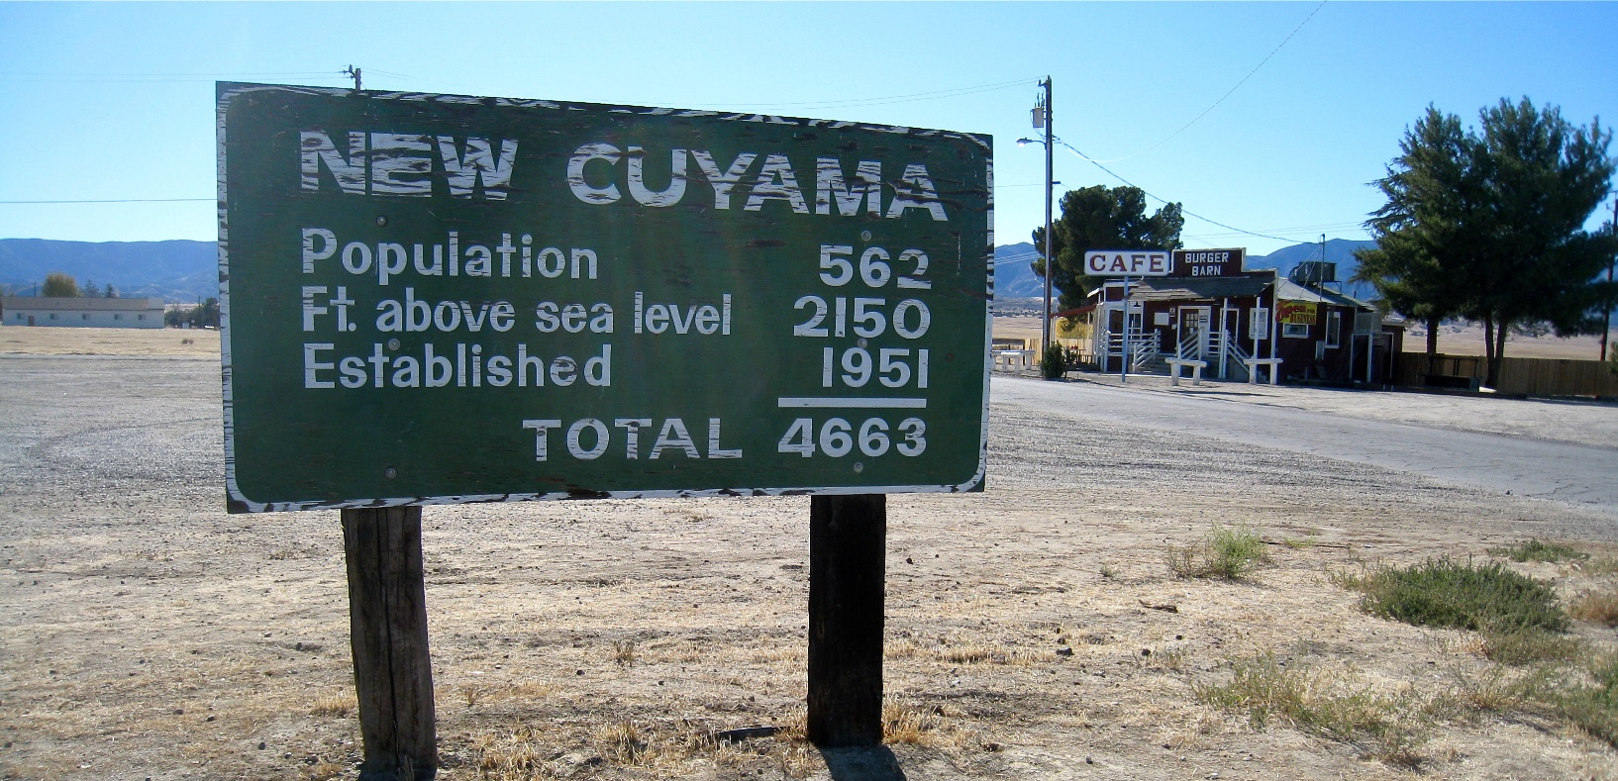
Not all integers are created equal
https://www.flickr.com/photos/7-how-7/4139229048/in/pool-1996770@N25/ licensed under
Creative Commons License
The interpretation tells you the meaning of each number. It also tells you
that you shouldn't be adding these integers!

Slide 25
Summary
You should now be able to write struct definitions, constructor templates, and interpretations for mixed, compound, and itemization data.

Slide 26
Next Steps
If you have questions about this lesson, ask them on the Discussion Board
Go on to the next lesson

